Slide 1
Image Processing Terms
History CNN
Intro to CNN Layers
Convolution Understanding

Slide 2
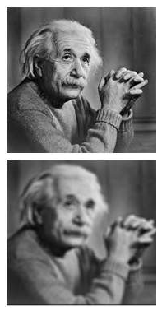
Image Resolution
Spatial Resolution
“The clarity of an image cannot be determined by the pixel resolution”
or
“Smallest discernible/perceptible detail in an image”
(Units – DPI, LPI, PPI)

Slide 3
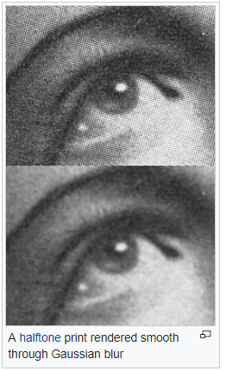
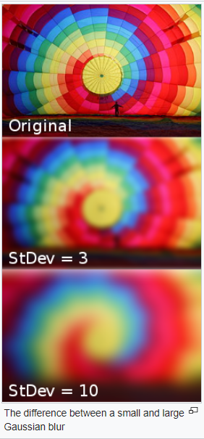
Image Resolution
Gaussian Blur/ Smoothing
Typically to reduce image noise and reduce detail
Zoom In/Out:
Pixel replication or (Nearest neighbor interpolation) – Row/Column
Zero order hold method - zoom twice
Zooming K times (both RxC)

Slide 4
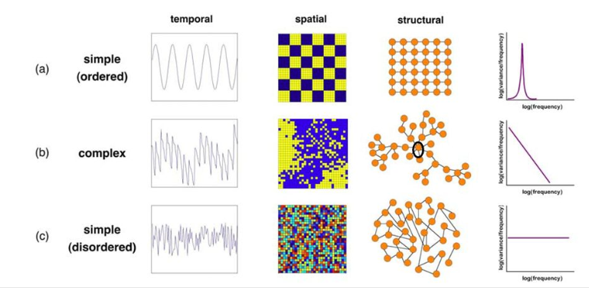
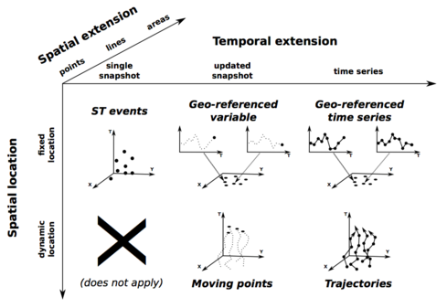
“Way to measure physical change” Temporal (Time)/ Spatial (Space)
Temporal : Perceived Differently with spatial 3d, so called 4th Dimension like past, present, future
Spatial (3D): Physical - basic directions in which we can move are up/down, left/right, and forward/backward.

Slide 5
Yann LeCun 1998
Introduction
Sparse Interactions - between layers simplified
2. Parameter Sharing - Same set of shared parameters
3. Equivariant Representation: f(g(x)) = g(f(x))

Slide 6
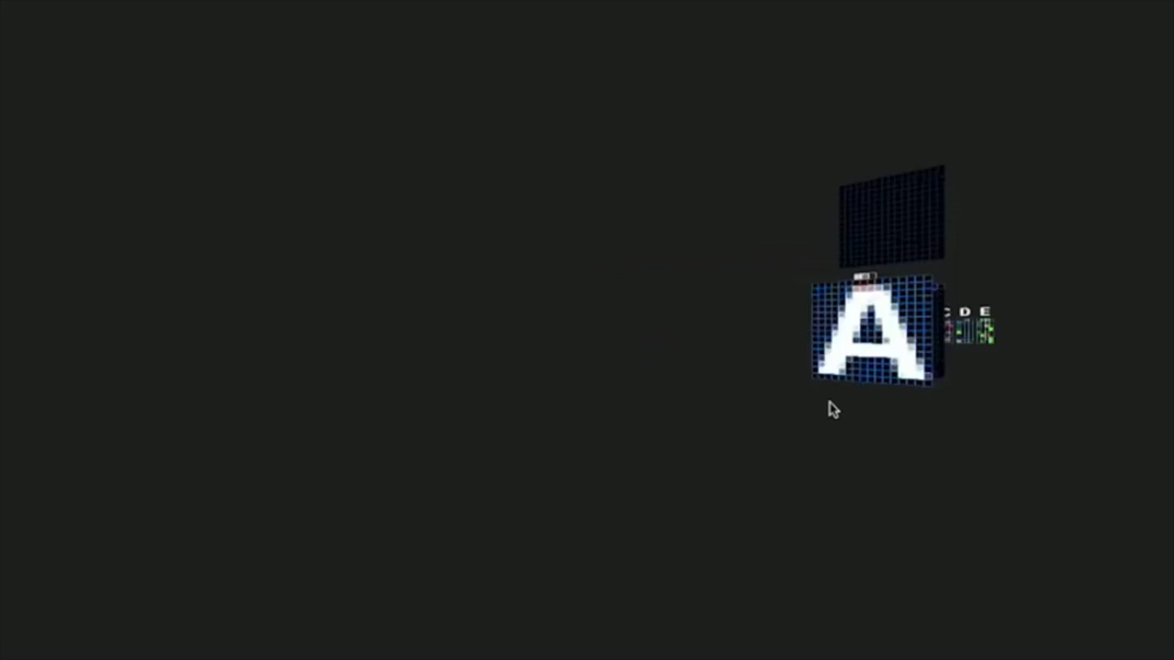
Visualize CNN

Slide 7
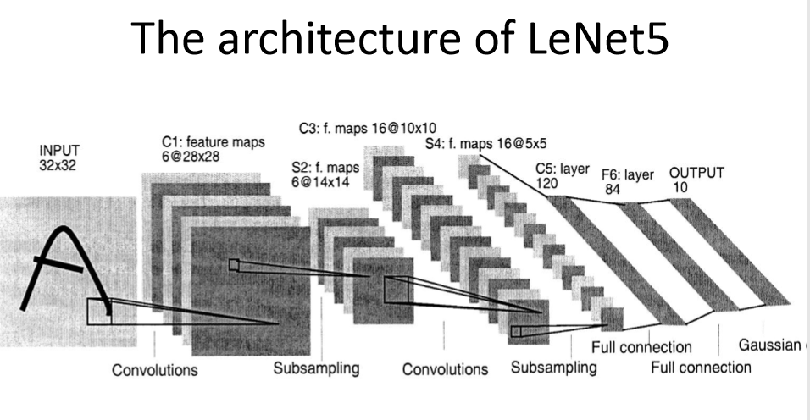
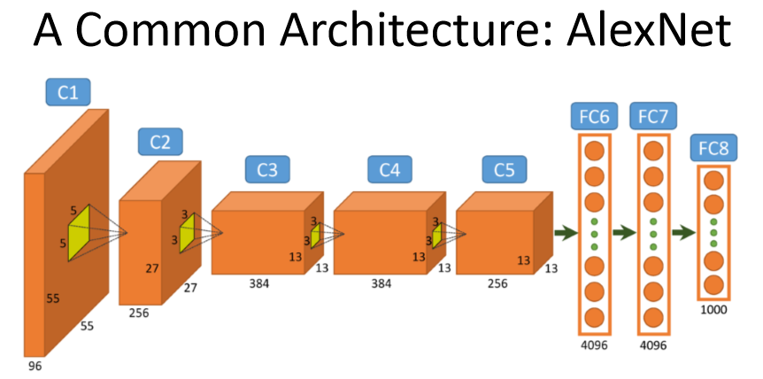

Slide 8
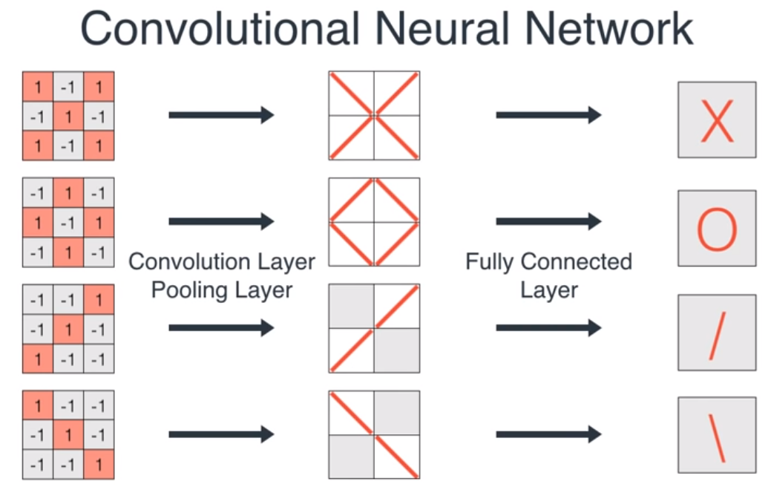
EXAMPLE

Slide 9
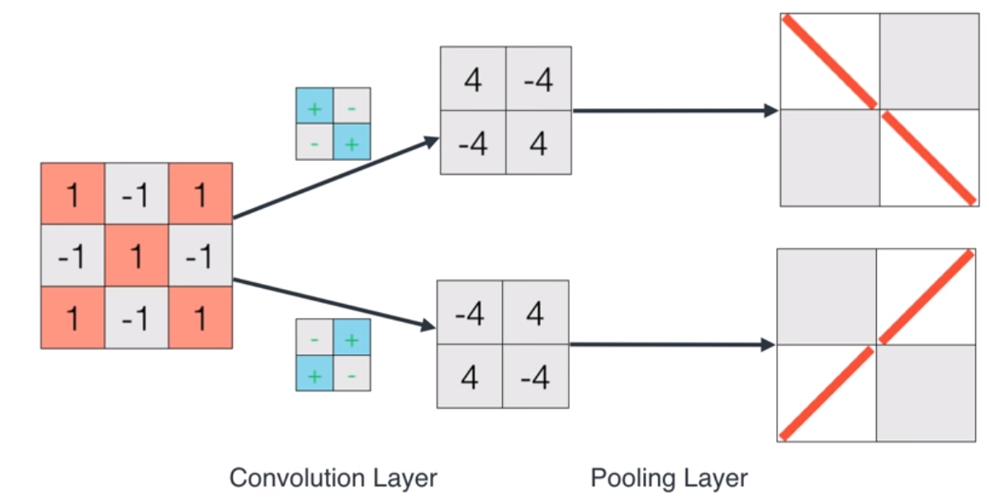
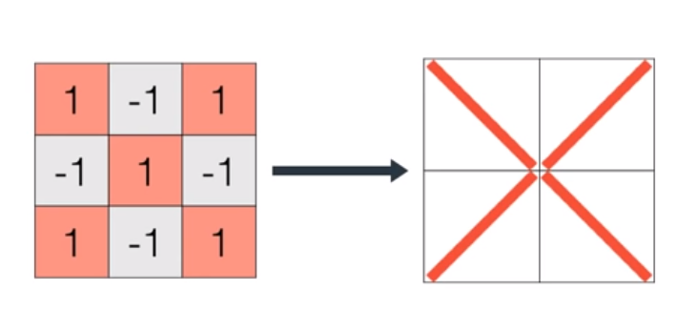

Slide 10
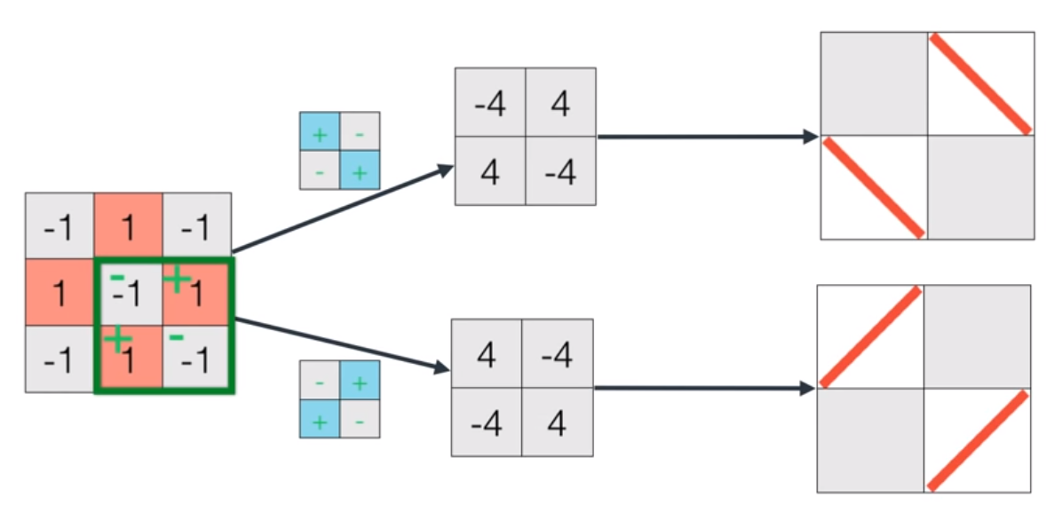
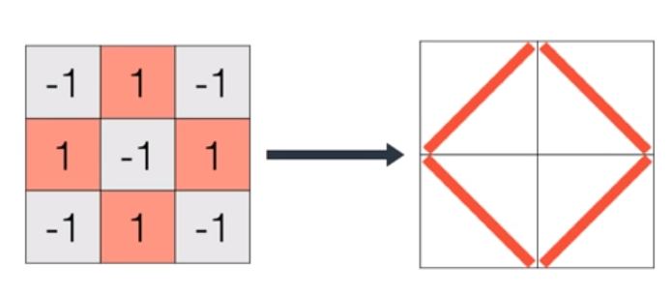

Slide 11
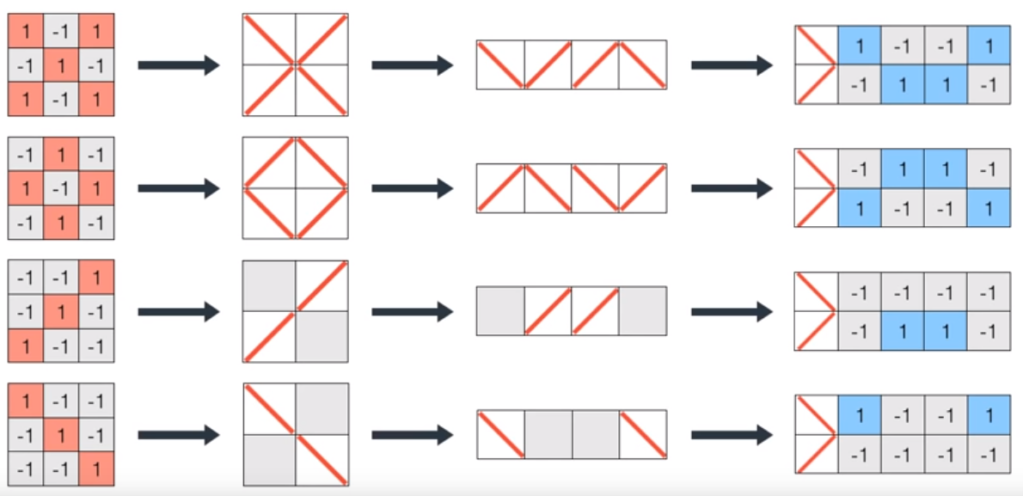

Slide 12
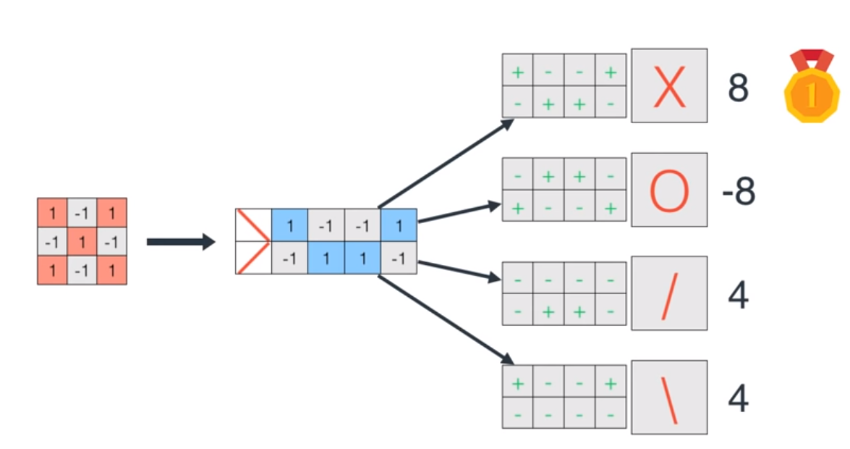
Edge Detection

Slide 13
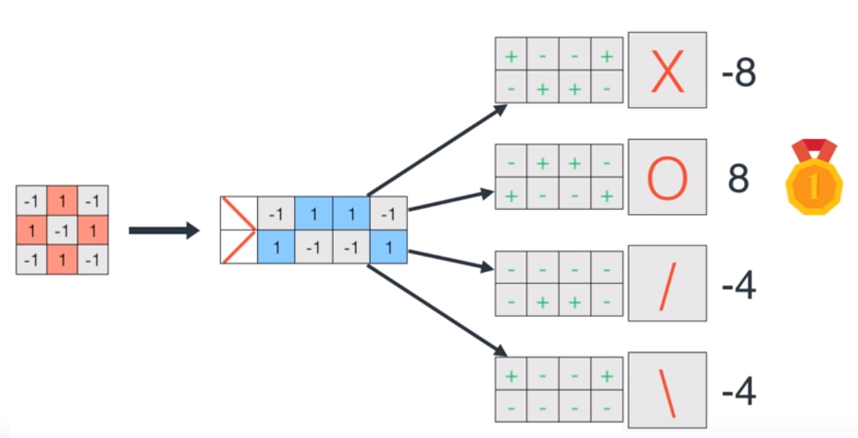
Edge Detection

Slide 14
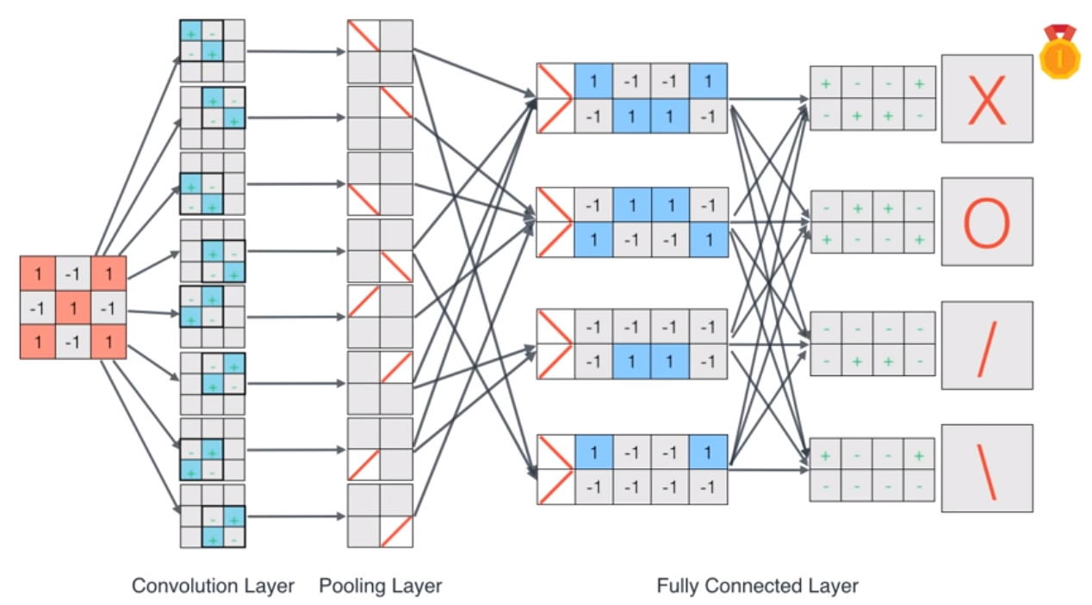
Edge Detection

Slide 15
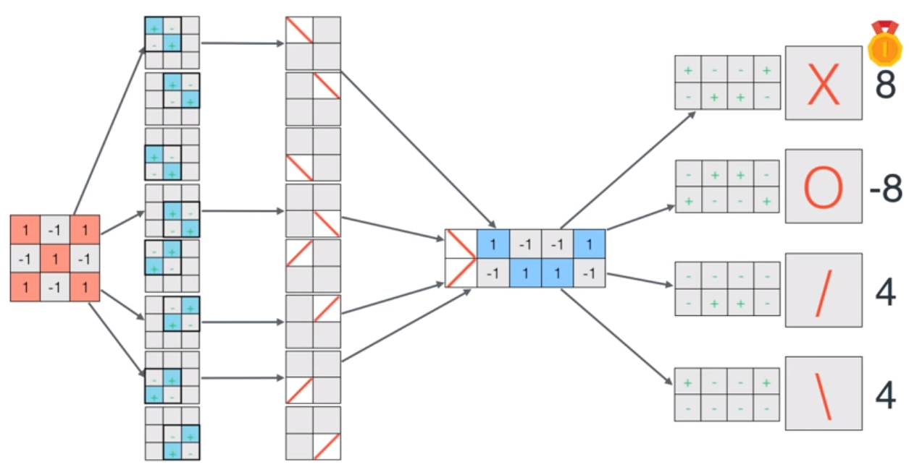
Edge Detection

Slide 16
LAYERS OF CNN [INPUT - CONV - RELU - POOL - FC]
Convolution - Kernel, Padding, Strides, I/O channels
Activation - Relu/Leaky Relu - making non-linear
Pooling - Down/Sub Sampling (Dimension, stride) - max, avg, min filters - maxPool2D - Valid Pool
Fully Connected - Flatten - 1D Feature Vector
Others:
Dropout
Dense

Slide 17
Convolution-2D
EDGE DETECTION FILTERS
(H, V, BOTH, SOBEL, SCHASS)
CNN WITH KERNEL
CNN WITH KERNEL + PADDING
CNN WITH KERNEL + PADDING + STRIDES

Slide 18
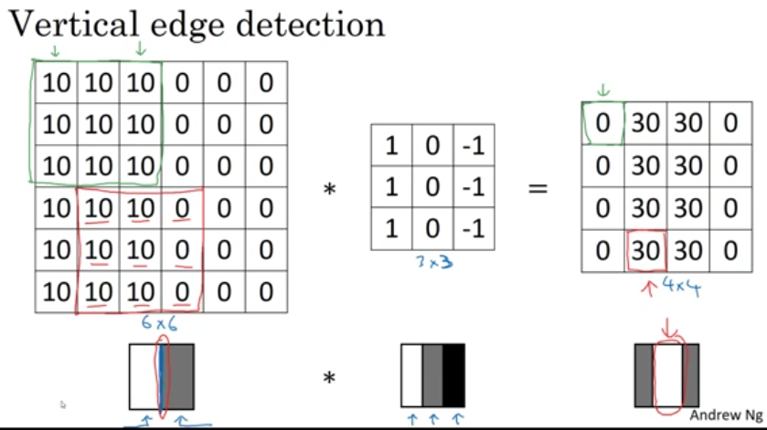
Edge Detection

Slide 19
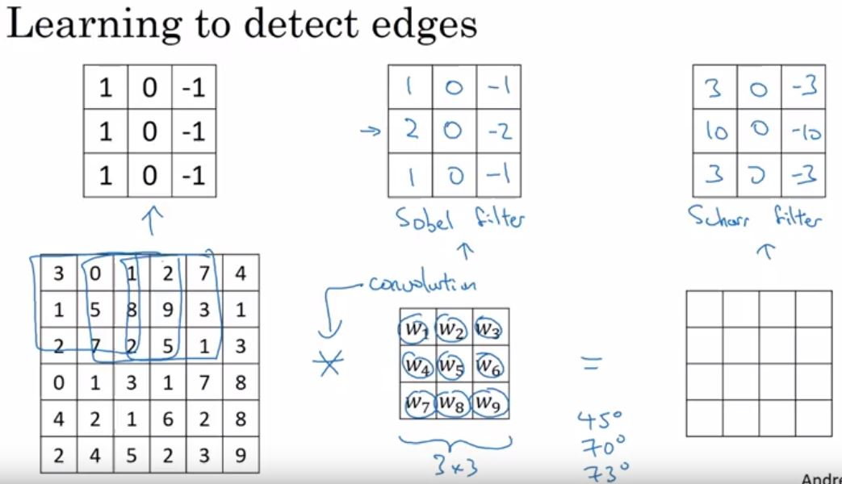
Edge Detection

Slide 20
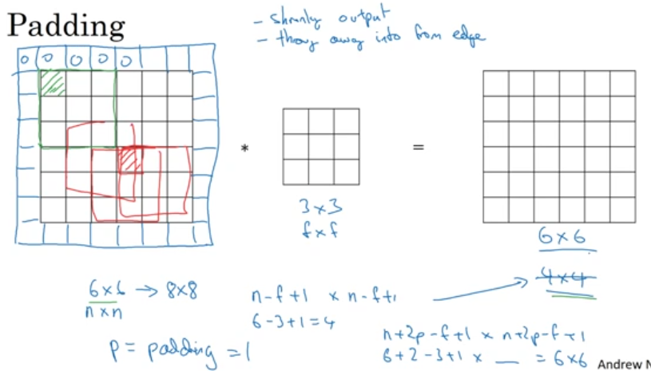
PADDING

Slide 21
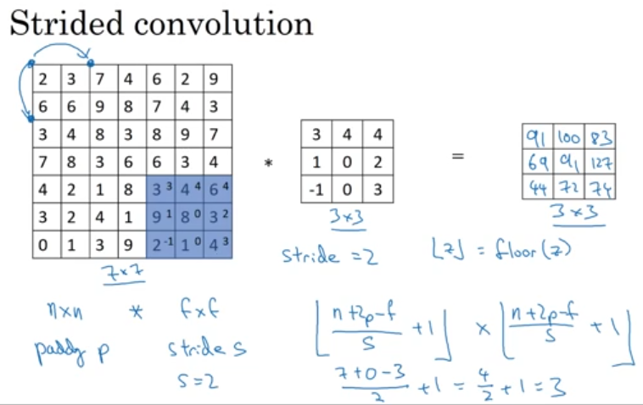
STRIDES

Slide 22
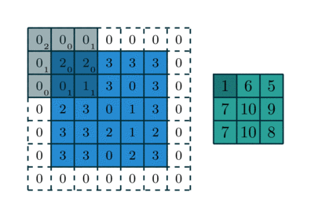
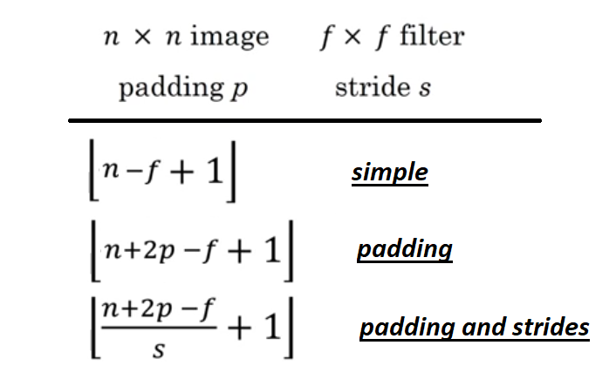
Image, Filter, Padding, Strides
5 x 5 3x3
Padding=1
Strides = 2
http://deeplearning.net/software/theano_versions/dev/tutorial/conv_arithmetic.html

Slide 23



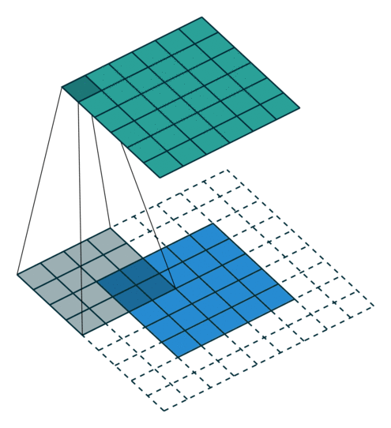

ALL TOGETHER/ MANY
http://deeplearning.net/software/theano_versions/dev/tutorial/conv_arithmetic.html
No zero padding, unit strides
Half Padding
Full Padding
No Zero padding, Non-unit strides
Zero padding, unit strides

Slide 24
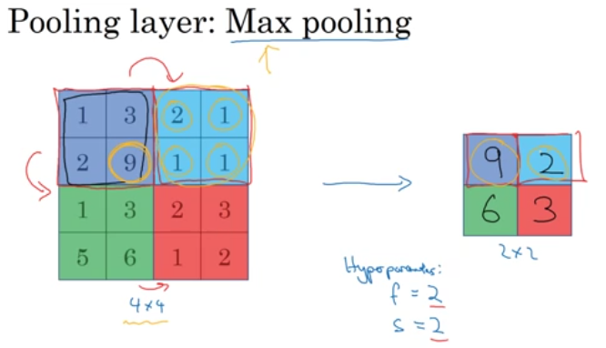
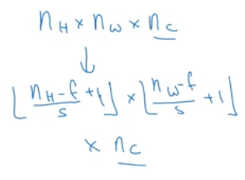
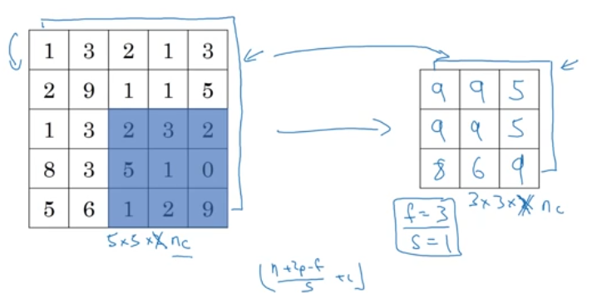
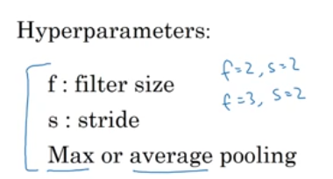
POOLING LAYER

Slide 25
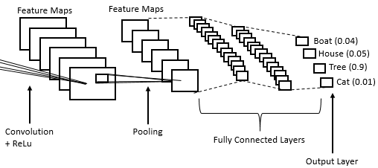
FLATTEN - FULLY CONNECTYED LAYER
Flattening a tensor means to remove all of the dimensions except for one.
Reshapes the tensor to have a shape that is equal to the number of elements
As making a 1d-array of elements.

Slide 26
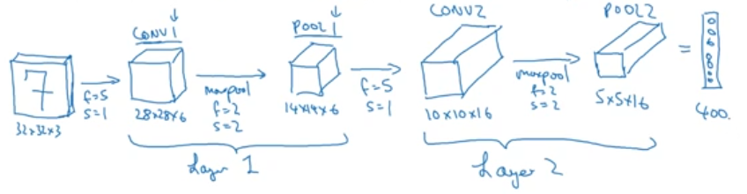
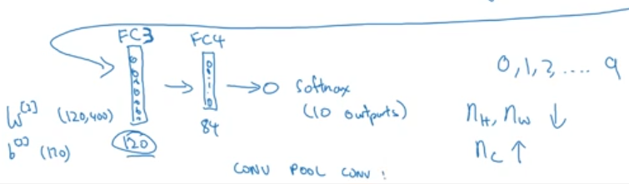
Conv. (Full Description - Params) (CONV -> POOL -> CONV -> POOL -> FC -> FC -> FC-> SOFT)

Slide 27
Conv. Full Description

Slide 28
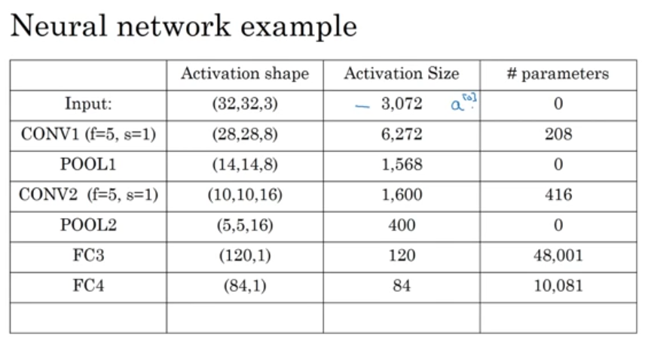
Conv. Parameters

Slide 29
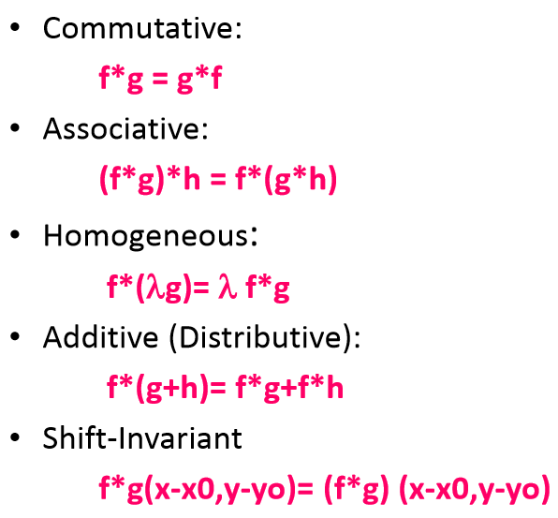
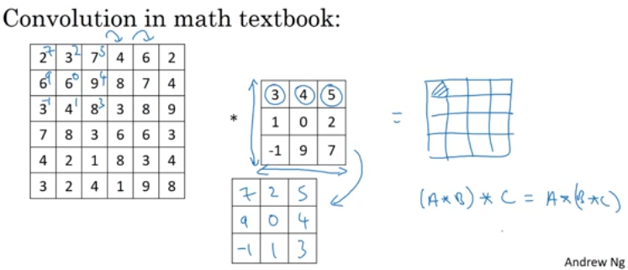
Conv. Properties

Slide 30
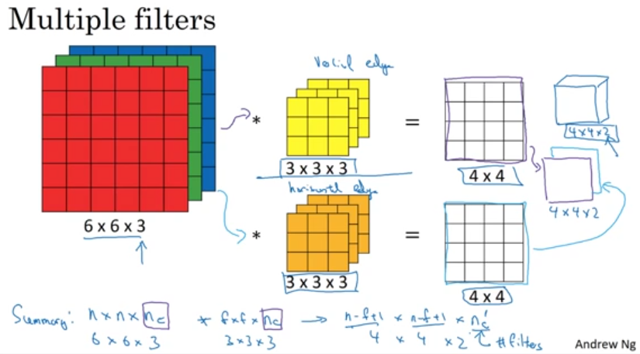
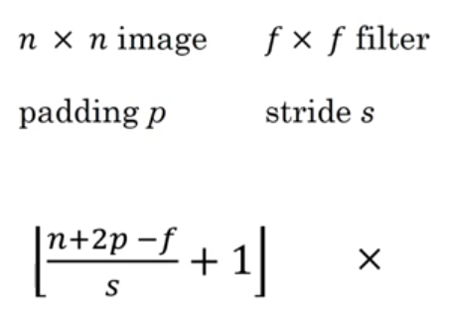
Image, Filter, Padding, Strides

Slide 31
Types of Convolutions :
0. Simple Convolution - Kernel, Padding, Strides, I/O channels
Dilated Convolutions –
3 x 3 kernel dilated into 3+2 x 3+2 (blanks 2) Used real-time segmentation.
2.Transposed Convolutions -
Deconvolutions or fractionally stride convolutions, Encoder-Decoder architectures
3. Separable Convolutions -
Separate Kernels - kernel operation into multiple steps, ie. both H, V Edges on two kernels, depth wise separable convolution - Xception model

Slide 32
Types of Convolutions :
0. Simple Convolution - Kernel, Padding, Strides, I/O channels
Dilated Convolutions –
3 x 3 kernel dilated into 3+2 x 3+2 (blanks 2) Used real-time segmentation.
2.Transposed Convolutions -
Deconvolutions or fractionally stride convolutions, Encoder-Decoder architectures
3. Separable Convolutions -
Separate Kernels - kernel operation into multiple steps, ie. both H, V Edges on two kernels, depth wise separable convolution - Xception model

Slide 33
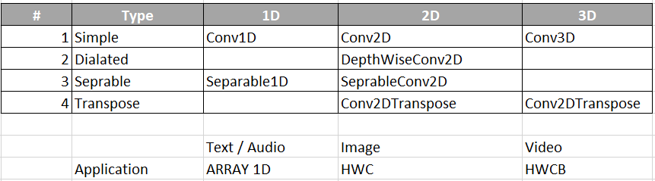
Types and Uses

Slide 34
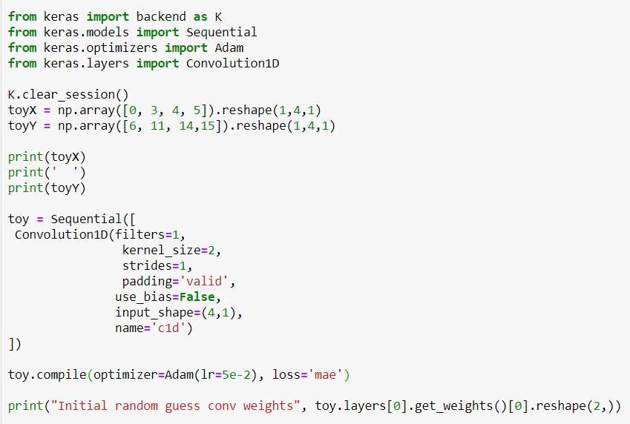
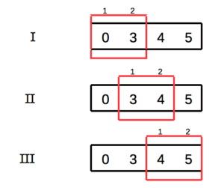
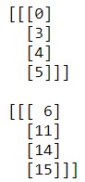
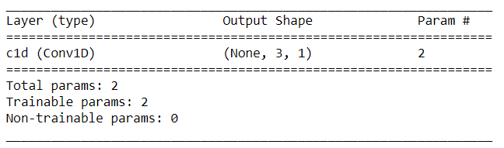
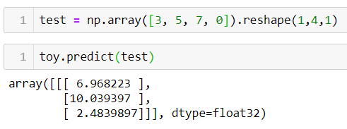
Conv1D Example (LR)

Slide 35
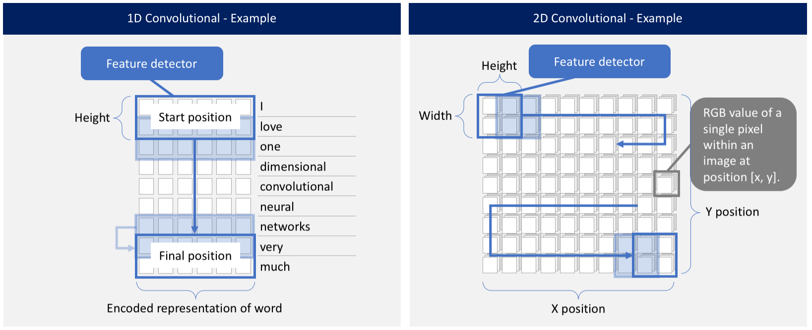
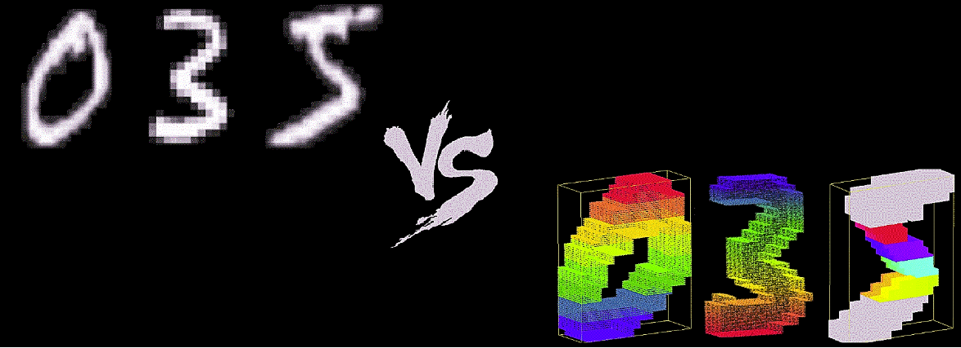
Conv1D vs 2D Time VS Space Domain
MNIST BW – 1D
MNIST COLOR – 2D

Slide 36
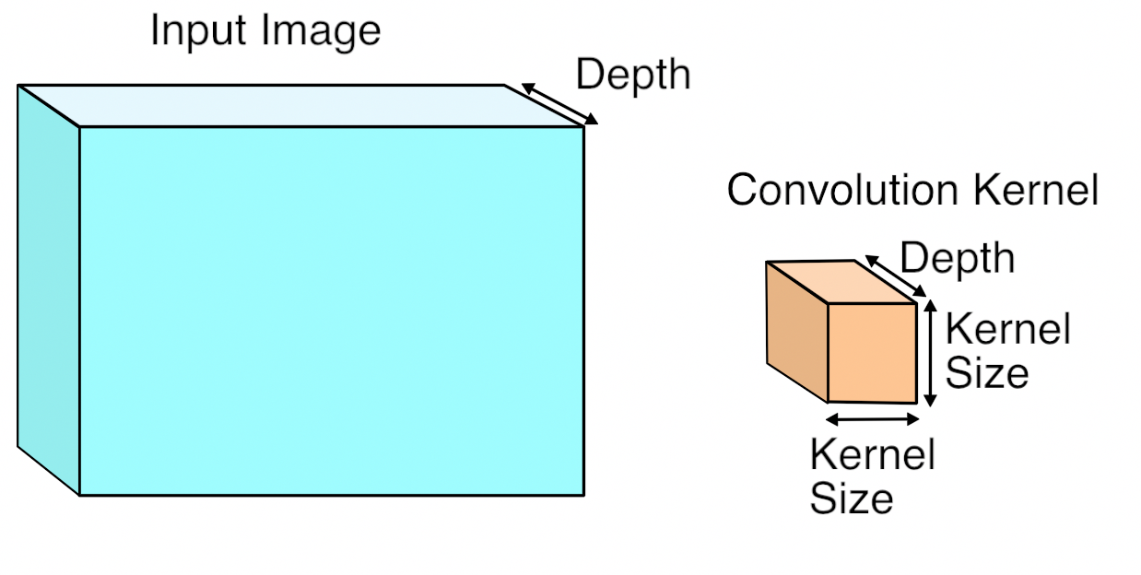
Conv2D (Kernel 2D)

Slide 37

Conv2D Visualize

Slide 38
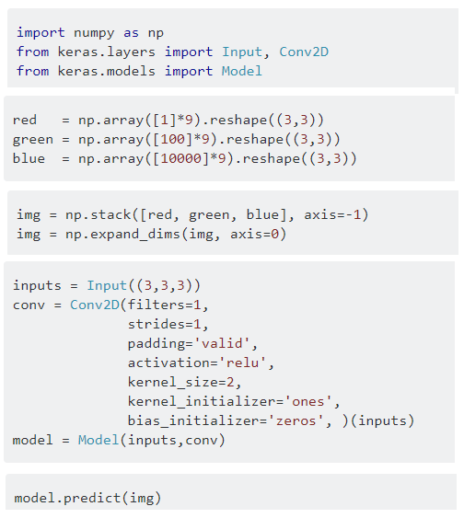
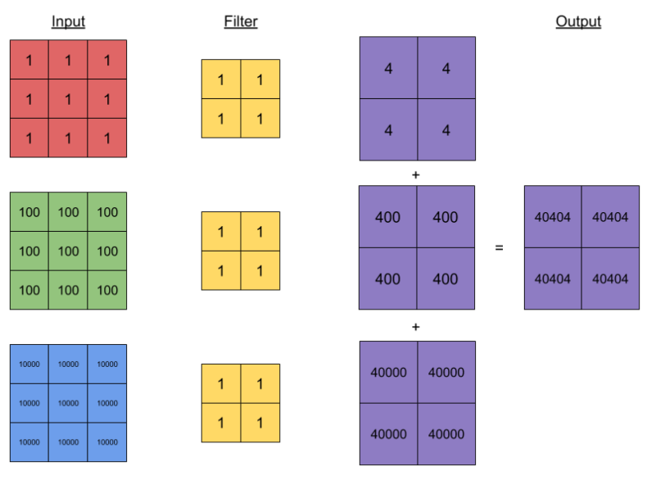
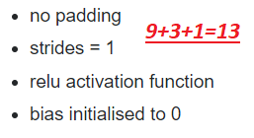
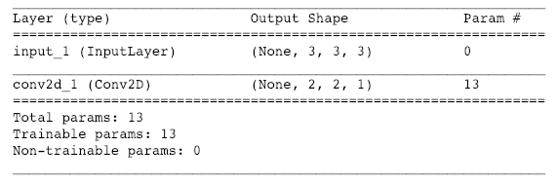
Conv2D - Basic

Slide 39
Conv1D vs 2D

Slide 40
Layers of Keras
MAIN LAYERS:
Conv1D (hw)
SeparableConv1D
Conv2D (hwc)
SeparableConv2D
DepthwiseConv2D
Conv2DTranspose
Conv3D (hwcb) Batch
Conv3DTranspose
OTHER LAYERS:
Cropping1D
Cropping2D
Cropping3D
UpSampling1D
UpSampling2D
UpSampling3D
ZeroPadding1D
ZeroPadding2D
ZeroPadding3D

